Slide 1


Data Structures
Lab: Binary Search Trees

Slide 2
Binary Search Tree (BST)
A binary tree in which for each node value of all nodes in the left subtree is less or equal and value of all the nodes in the right subtree is greater.
BST
<=
BST>

Slide 3
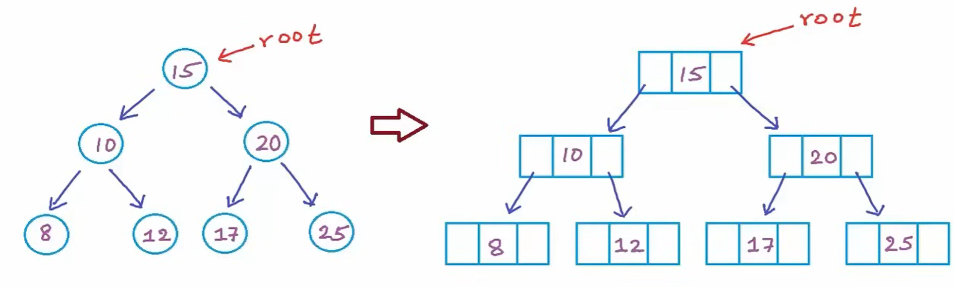
BST

Slide 4
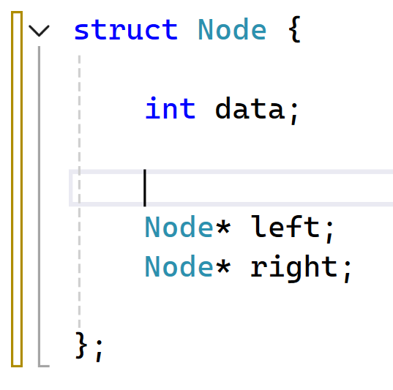
BST
Value to be store. It can be of any data type.
These will be used to store the node address of the subtress.

Slide 5
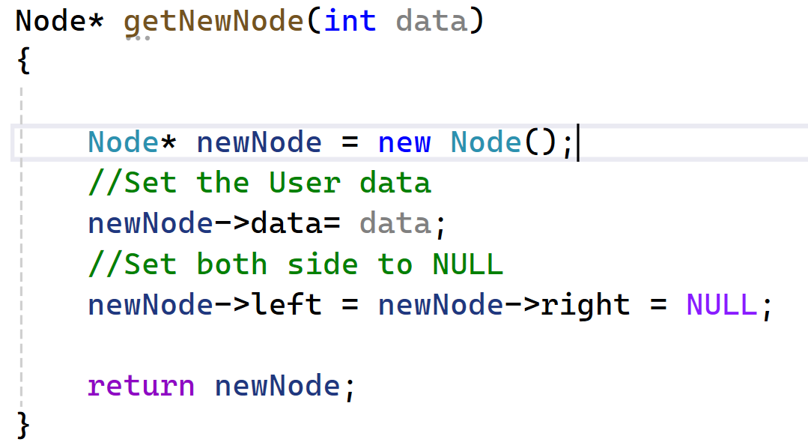
BST

Slide 6
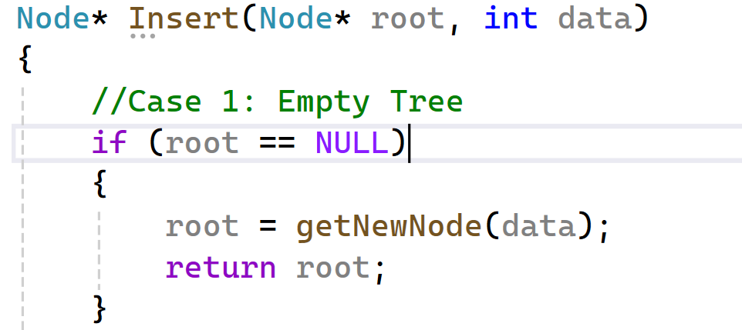
BST

Slide 7
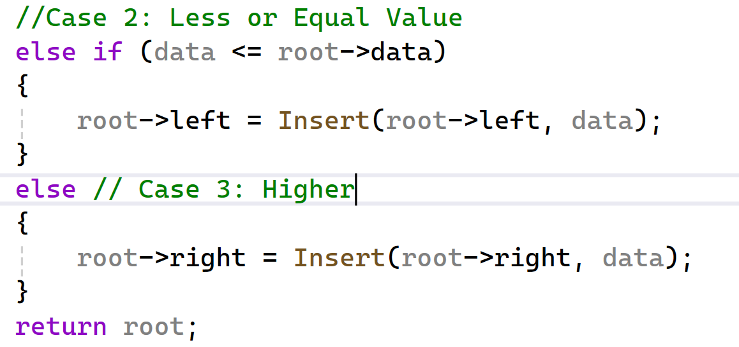
BST

Slide 8
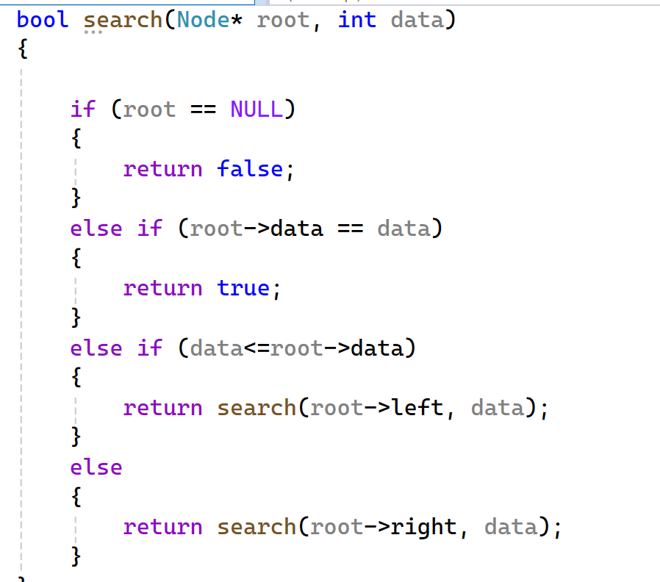
BST

Slide 9
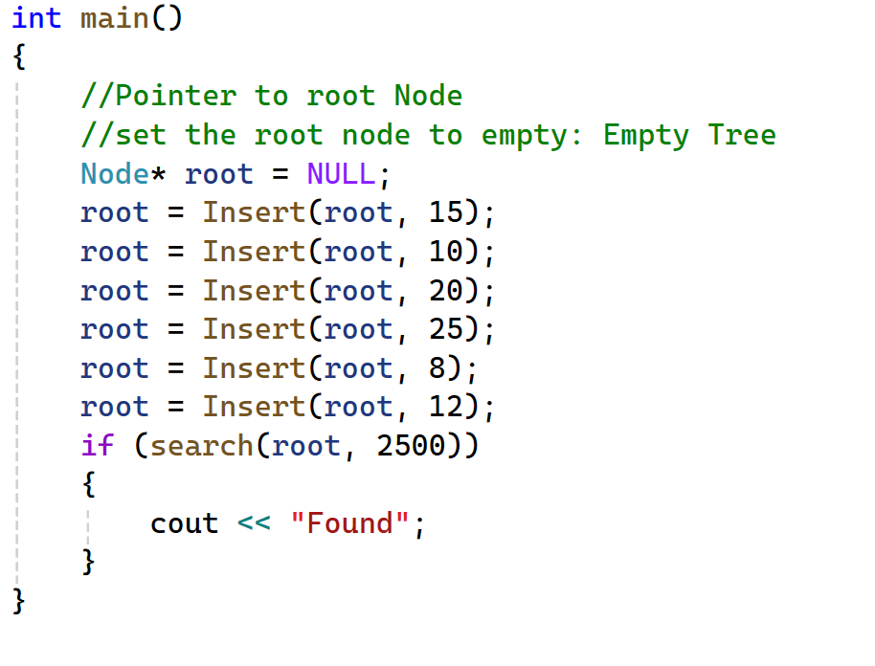
BST

Slide 10

THANK YOU!

